Slide 1
Real Estate & Open Data Analytics
Presented by:
Jim DeLisle, May 2019

Slide 2
Presentation Preview
Introduction to Data Analytics
Data Analytics Process
Sources of Date in Real Estate
Integrating Data & Analytics
Sources of Open Data
Process
Example v2V Land Bank

Slide 3
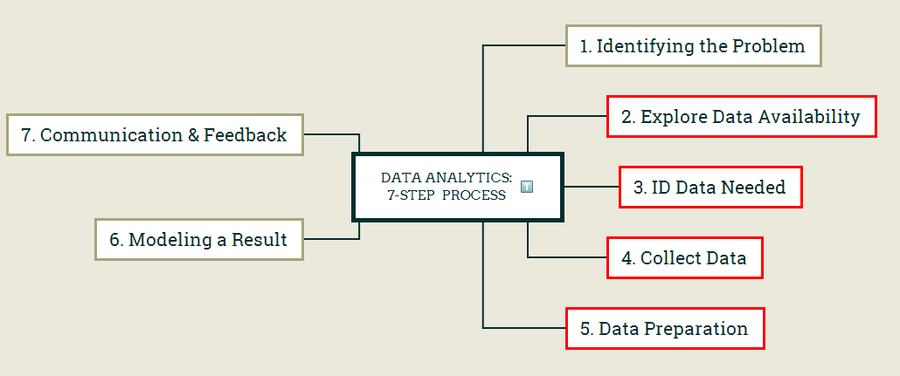
7-Step Process

Slide 4
Sources of Open Data: Overview

Slide 5
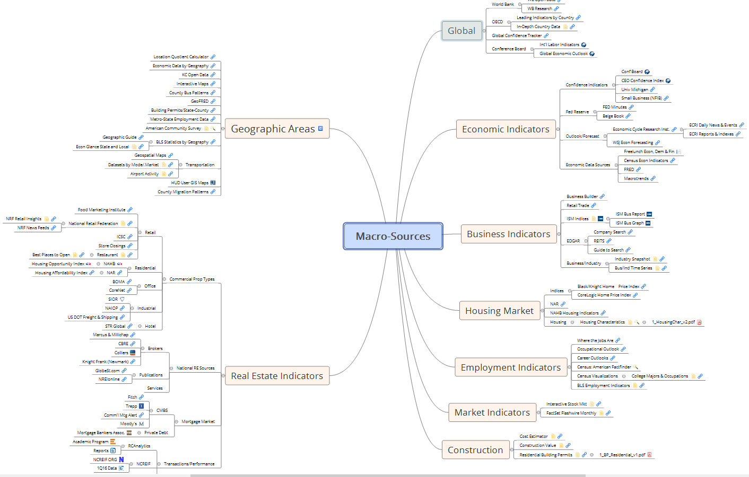
Macro-
Real
Estate
Data
Sources

Slide 6
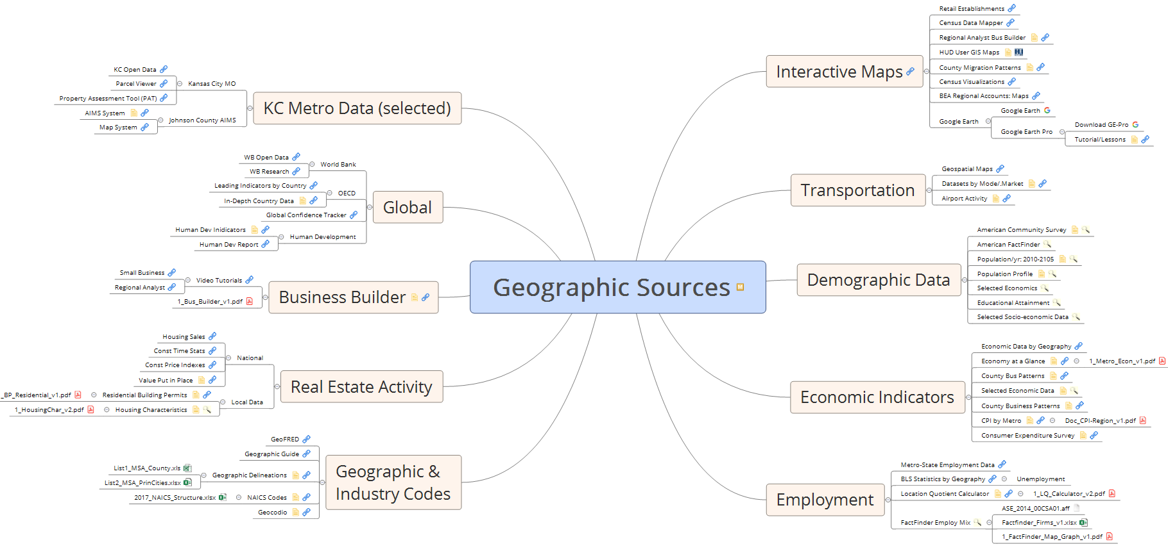
Geographic RE Sources of Data

Slide 7
Sources of Open Data: KCMO

Slide 8
Open Datasets in KCMO (Selected)
Datasets
  Land Bank: the inventory and status of acquired and disposed residential improved properties
  Crime: incident reports compiled by the KCPD that feeds into the FBI’s Criminal Justice Information System (CJIS) data system with IBRS codes.
  311 Requests: citizen-generated complaints or queries mapped to individual properties reported by category and type.
  Property Violations: property-specific violations that recorded by KC-MO in its monitoring and compliance system related to individual properties.
  Building Permits: a range of property-specific building activities including renovations, expansions, new construction, and demolitions.
  Demolitions: Properties on the $10m demolition list
  Dangerous Buildings: Dynamic List of Dangerous Buildings
  Business Licenses: License by Category
Temporal Frame
  Datasets: 2010-2018
  Land Bank: 2013-2018

Slide 9
Multi-stage research process
Problem Statement
Data Development
Data Identification
Research & Output
Exploratory Analysis
Focused Issue: Abandoned Housing
Geospatial
Major Issue: Urban Blight
Approach:
Data Capture
Data Scrubbing
Data Blending
Model Specification
Empirical/Spatial Analysis
Findings
Implications
Residuals: Next Steps
Theoretical

Slide 10
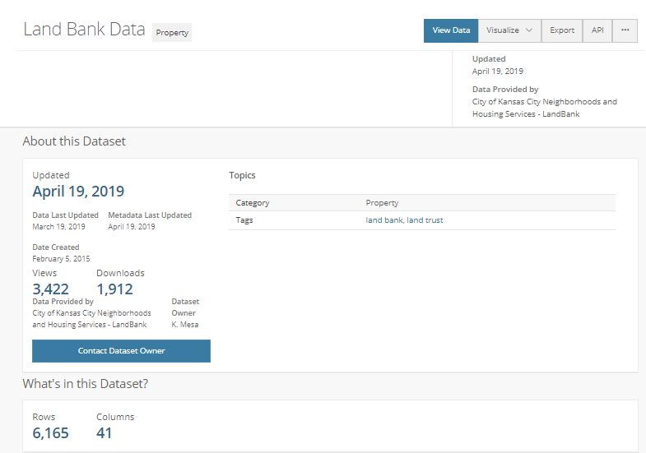
Land Bank Data
https://data.kcmo.org/Property/Land-Bank-Data/2ebw-sp7f

Slide 11
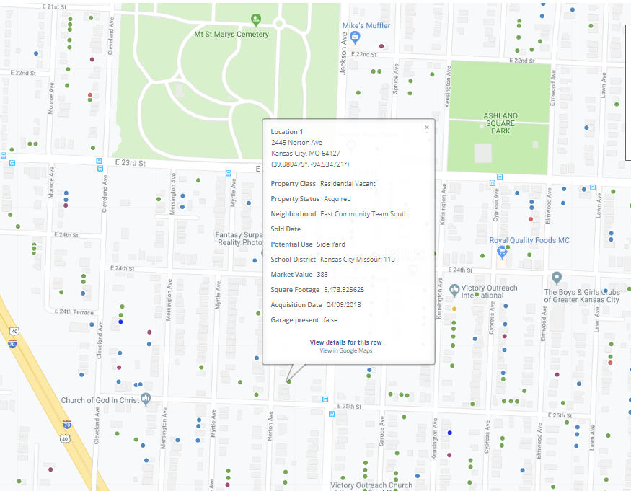
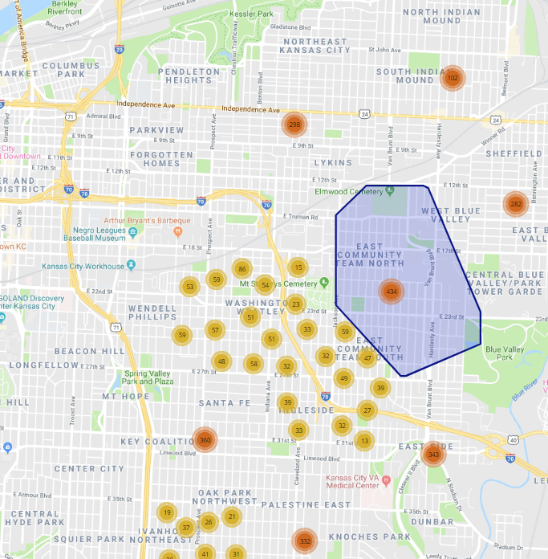
Land Bank Map

Slide 12
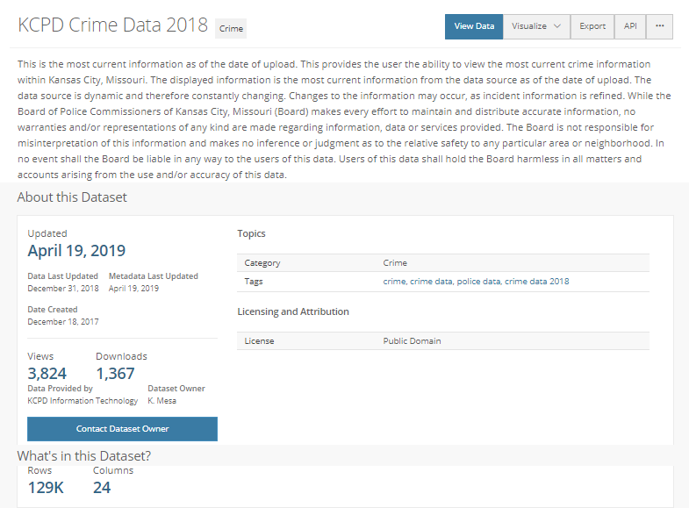
Crime: Annual Report
https://data.kcmo.org/Crime/KCPD-Crime-Data-2018/dmjw-d28i

Slide 13
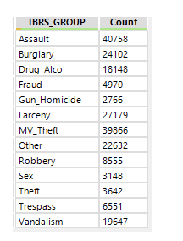
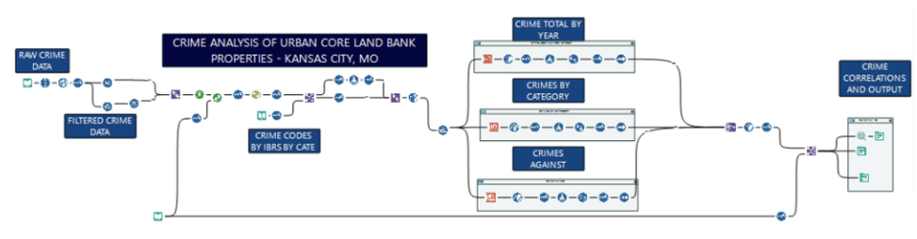
Crime Workflow

Slide 14
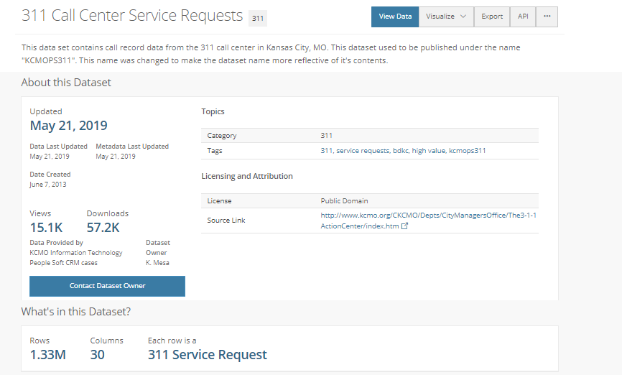
311 Calls
https://data.kcmo.org/311/311-Call-Center-Service-Requests/7at3-sxhp

Slide 15
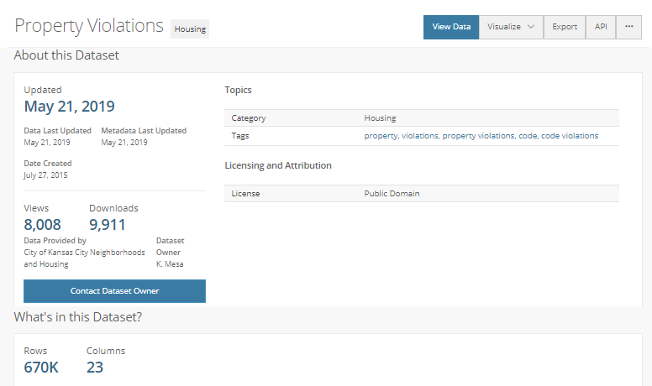
Property Violations
https://data.kcmo.org/Housing/Property-Violations/nhtf-e75a

Slide 16
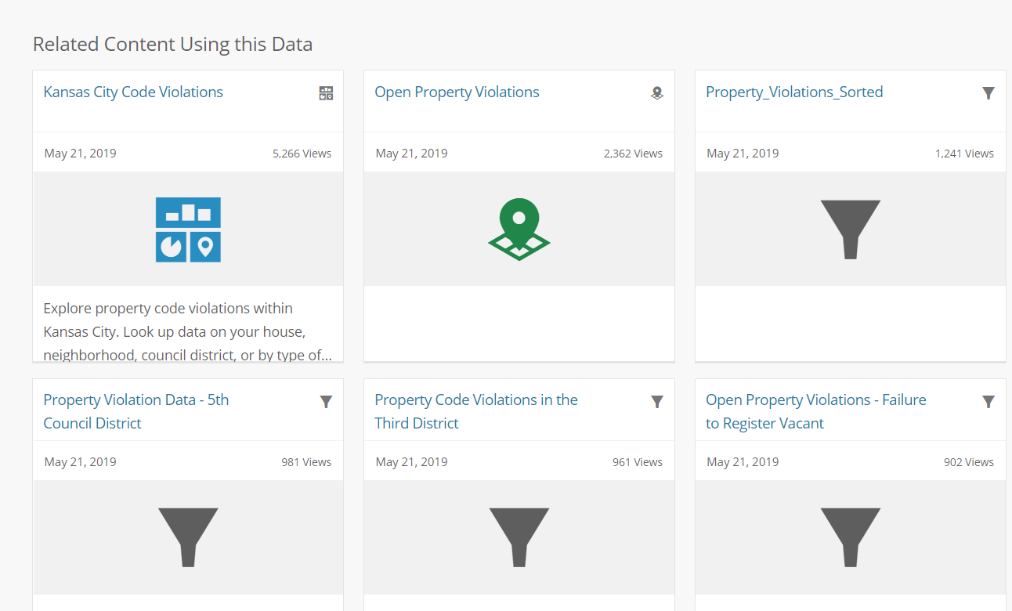
Property Violation Links

Slide 17
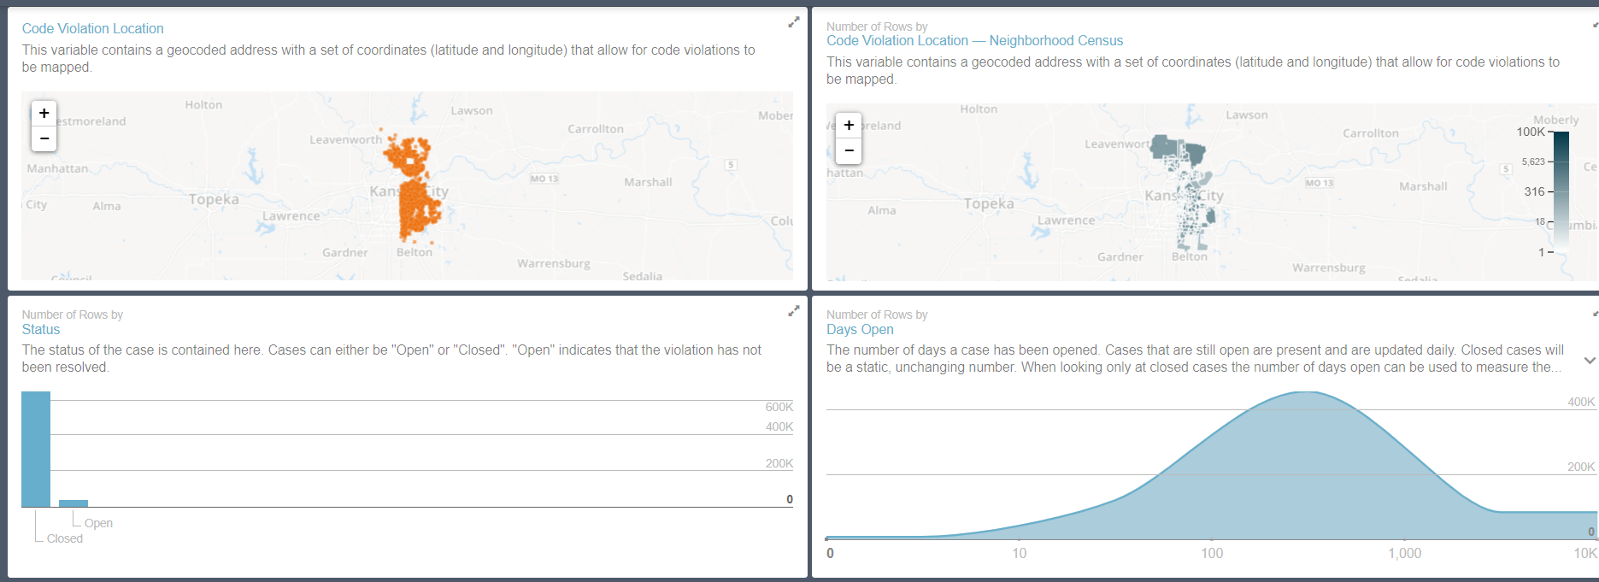
Property Violation Dashboard: KCMO
https://data.kcmo.org/Housing/Kansas-City-Code-Violations/mnjv-uy2z

Slide 18
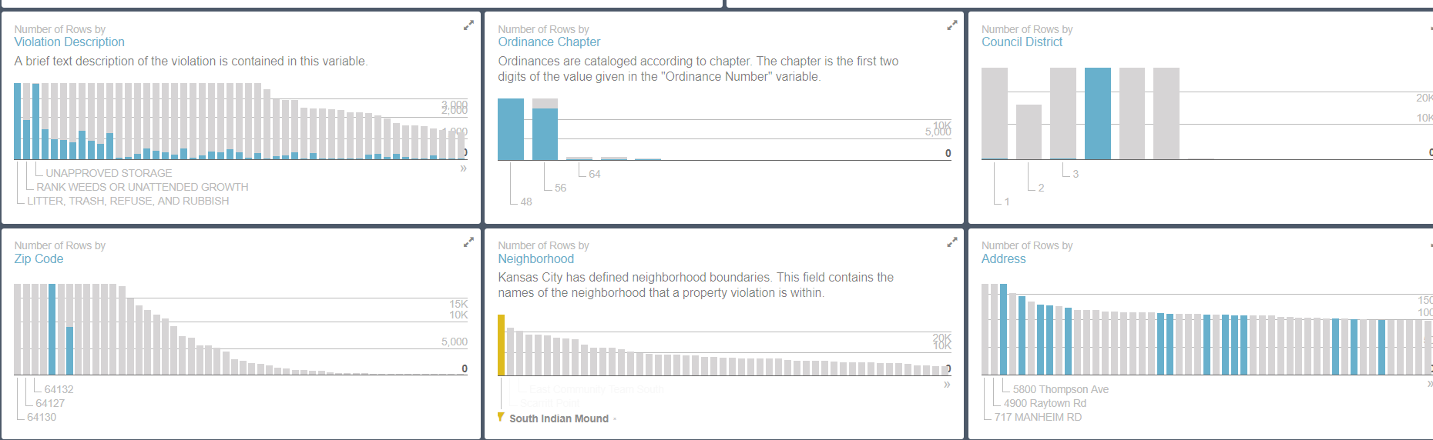
Property Violation: Interactive Map

Slide 19
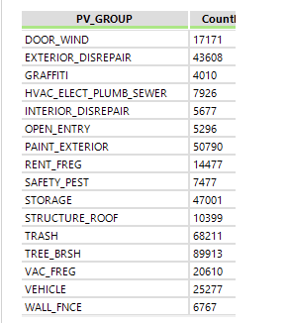
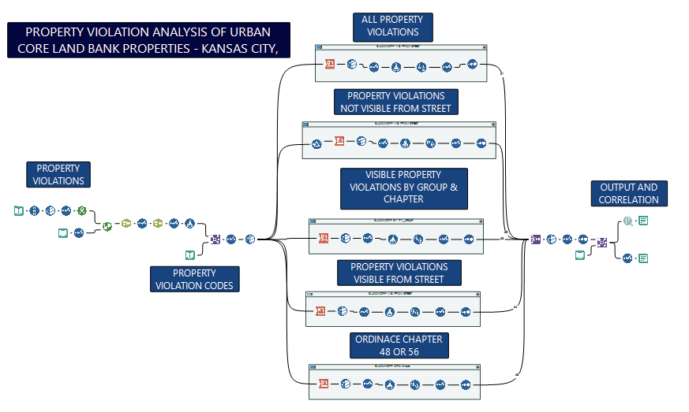
Property Violation Workflow

Slide 20
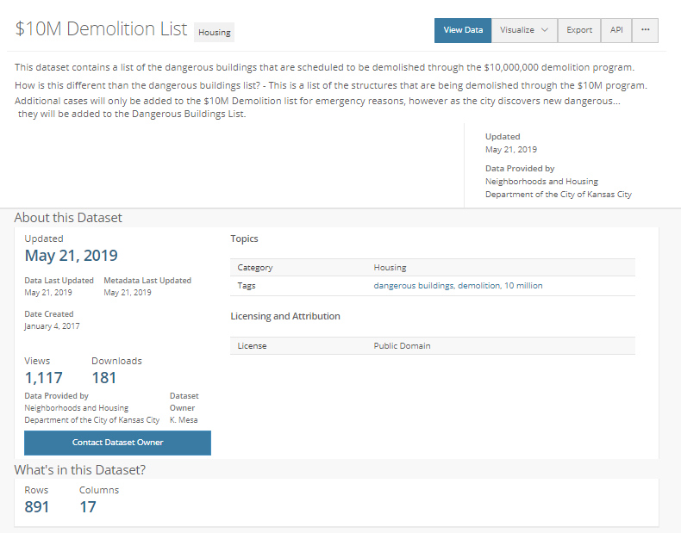
$10m Demolition List

Slide 21
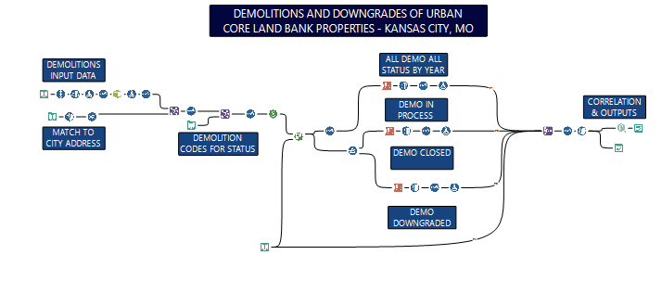
Demolition Workflow

Slide 22
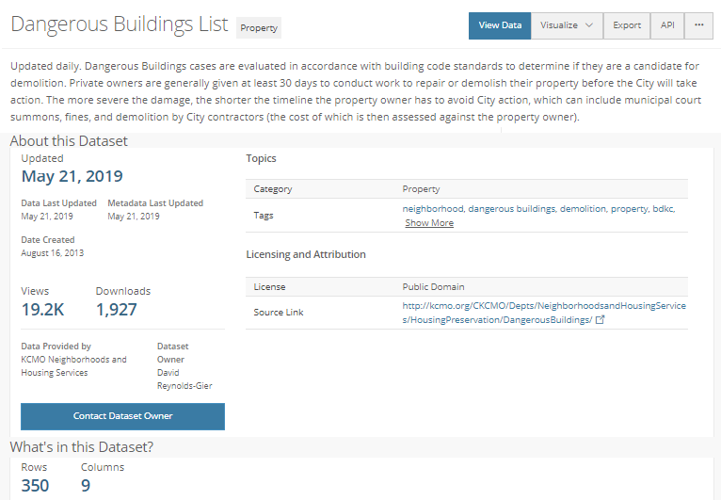
Dangerous Building List
Dashboard
https://data.kcmo.org/Property/Dangerous-Buildings-in-Kansas-City/vrr3-2j29
https://data.kcmo.org/Property/Dangerous-Buildings-List/ax3m-jhxx

Slide 23
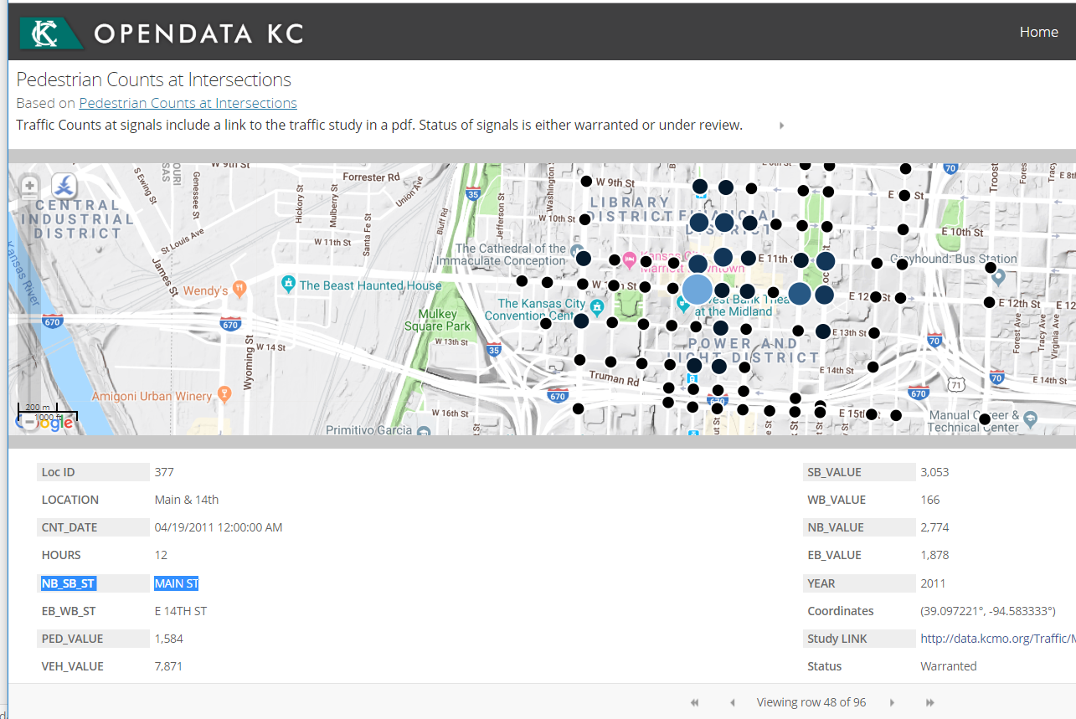
Pedestrian Traffic Counts at Intersections
https://data.kcmo.org/Traffic/Pedestrian-Counts-at-Intersections/t7fm-5t7t

Slide 24
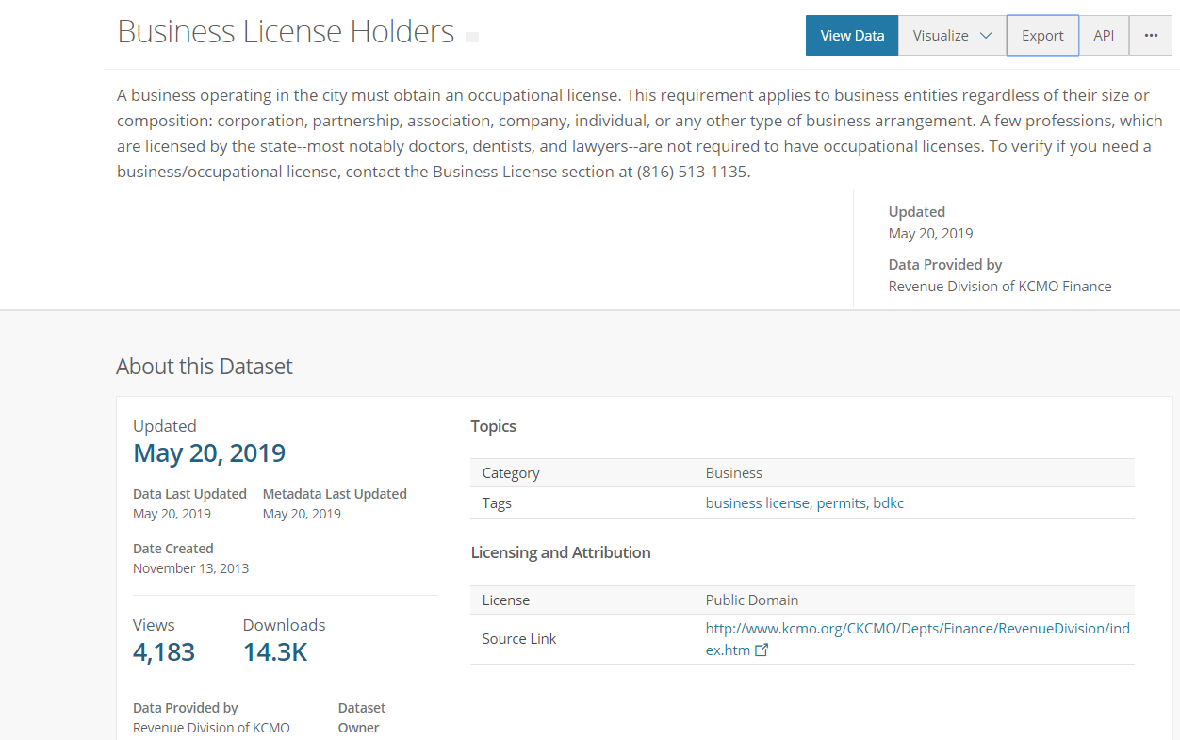
Business License Holders
https://data.kcmo.org/Business/Business-License-Holders/pnm4-68wg

Slide 25
Classification of Datasets
PVs: 481
CRIMES: 60
311 Requests: 356
Against Groups

Slide 26
Applications: What is the Question?

Slide 27
v2V Product Development and Operation
Problem Statement
Data Development
Analysis & Output
Exploratory Analysis
Focused Issue: Abandoned Housing
Major Issue: Urban Blight
Case Study: Land Bank of Kansas City
User Identification: Personas
Mock-up
User Experience Testing
Website Launch
Improve Housing Access, Equity
Stabilize/Revitalize Neighborhoods
Maintenance
Enhancement
Extension: Scalability
Data Aggregation
Data Scrubbing
Data Capture
Data Identification

Slide 28
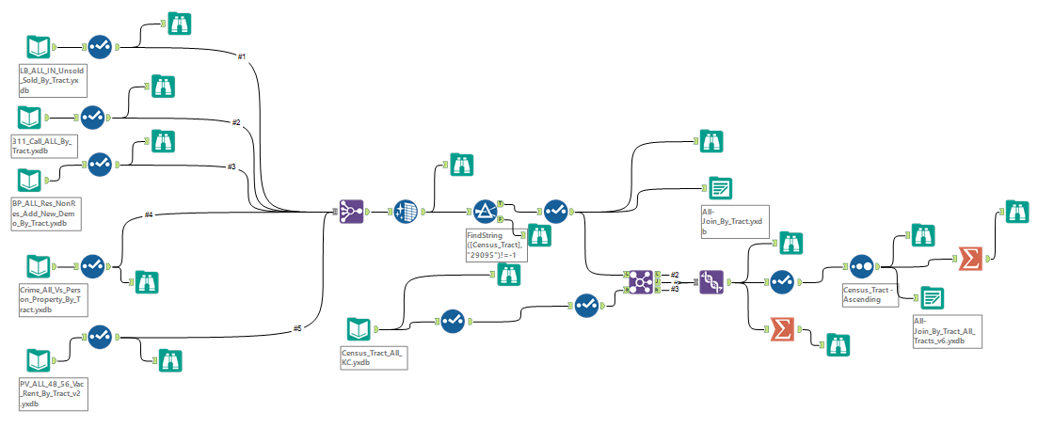
Join Data to
Geography

Slide 29
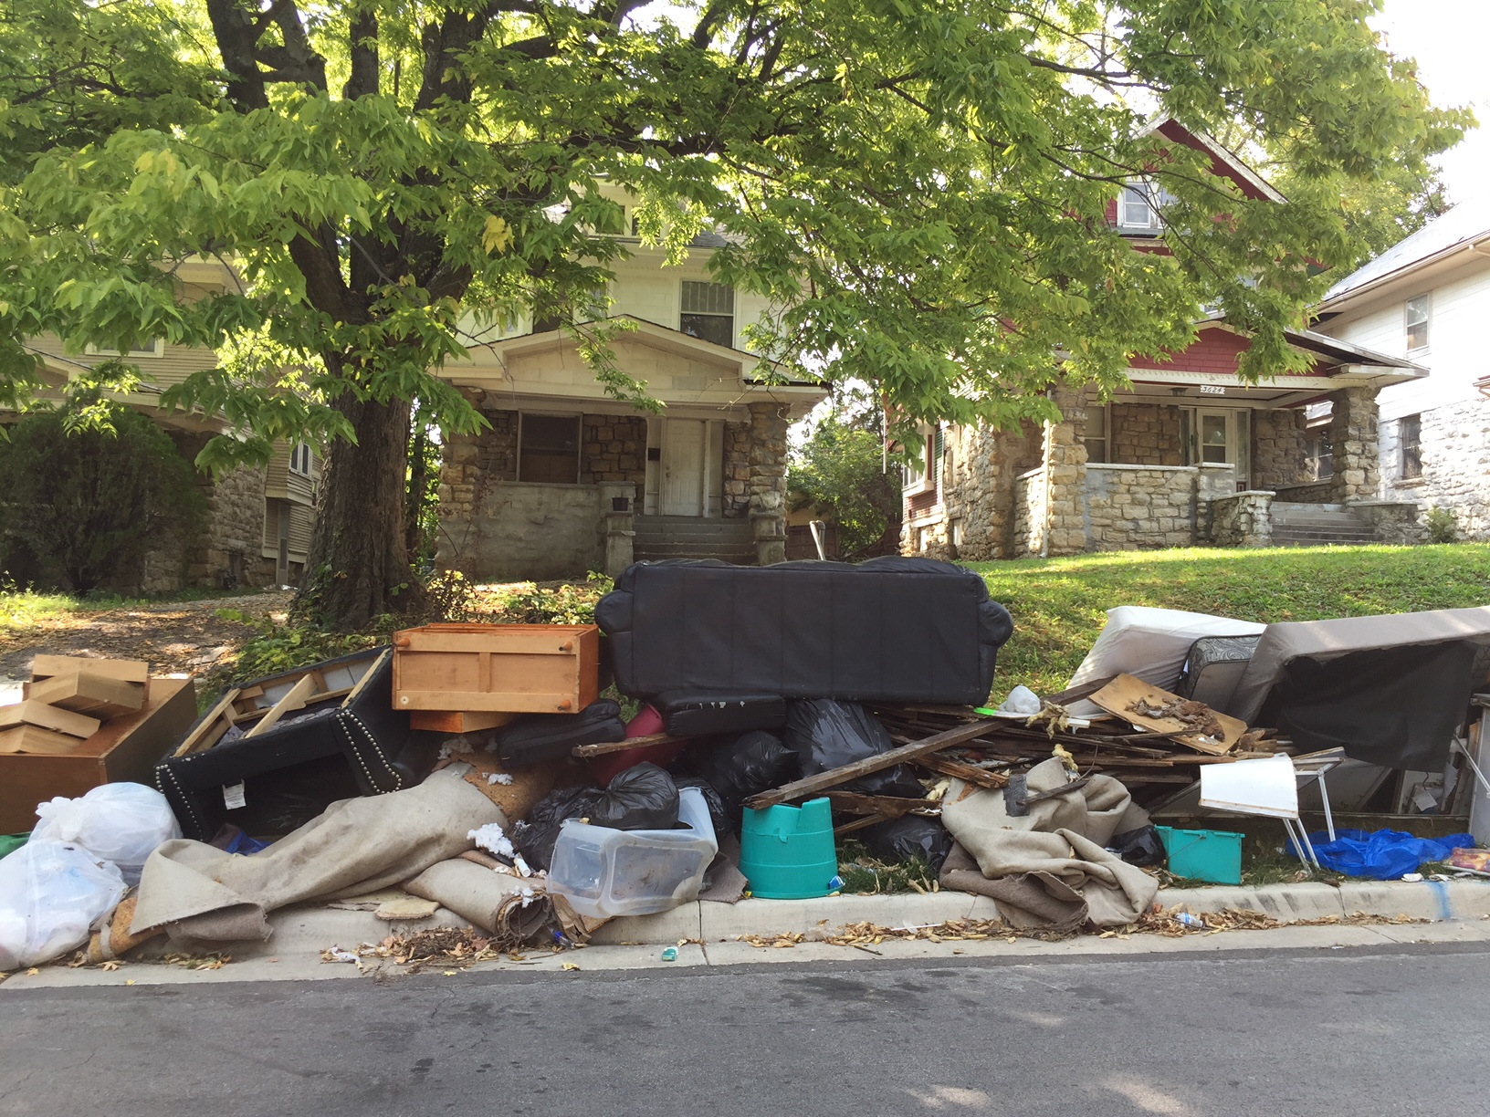
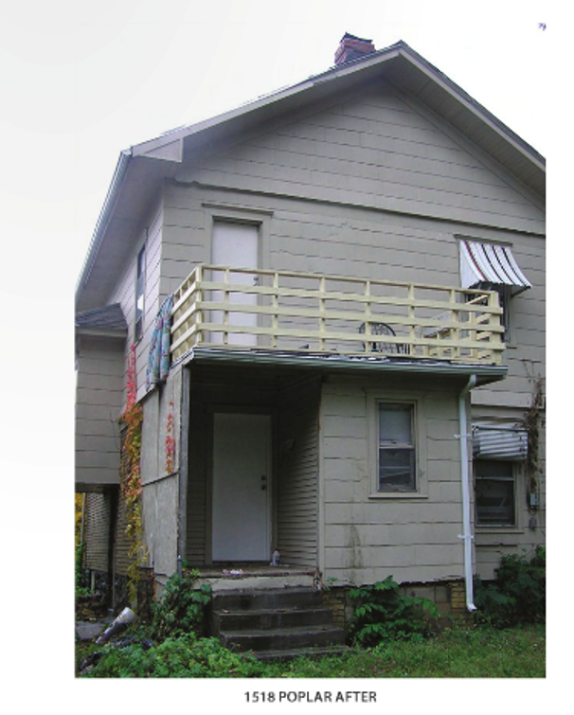
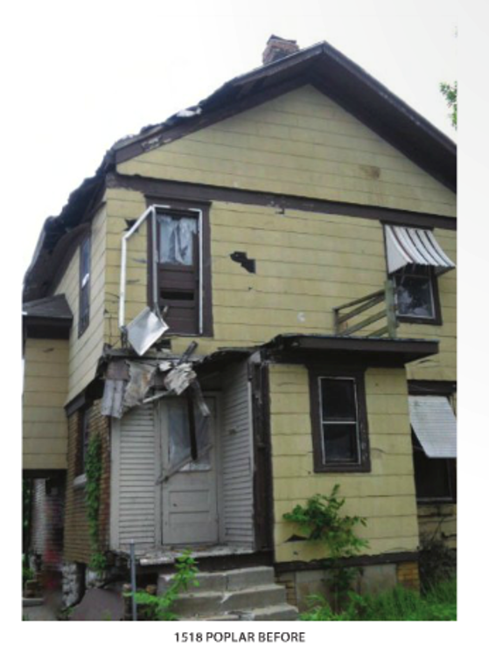
Open Data: Abandonment Housing & Environs
Abandonment/Sale = f(Property & Place)
Place = f(Property & Environ Conditions)
Crime
311 Call Requests
Property Violations
Building Permits
Crime
311 Call Requests
Property Violations
Building Permits
Crime
311 Call Requests
Property Violations
Building Permits
Pre-Abandonment
Abandonment
Sale
Post-Sale

Slide 30
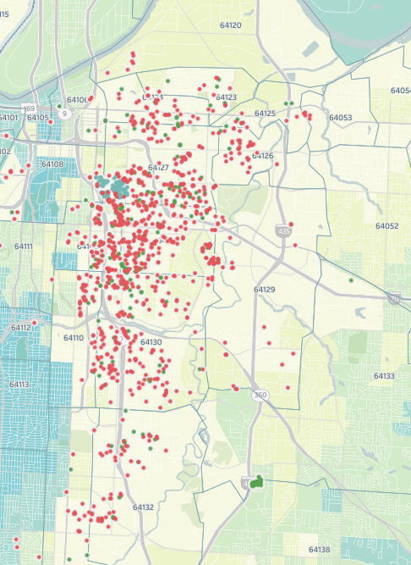
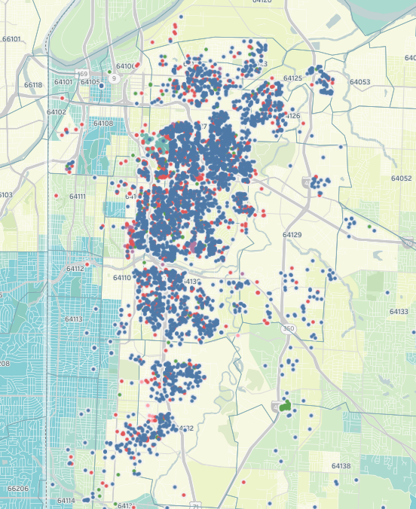
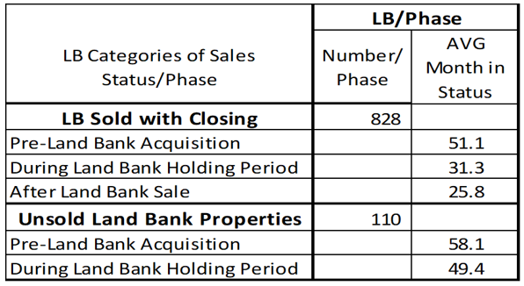
Application 1: Land Bank States
(Before, During & After)
Sold Land Bank
Total Land Bank
Residential Improved LBs

Slide 31
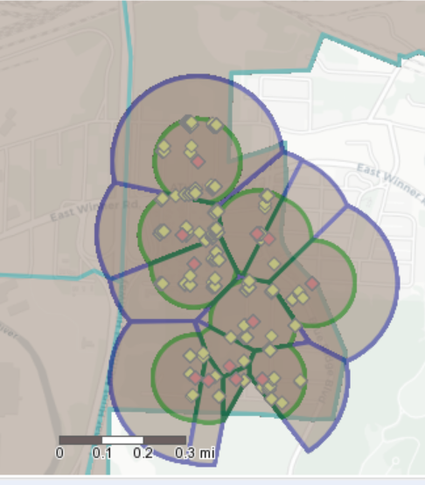
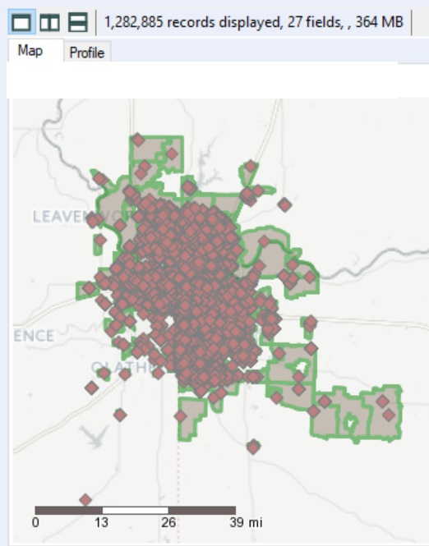
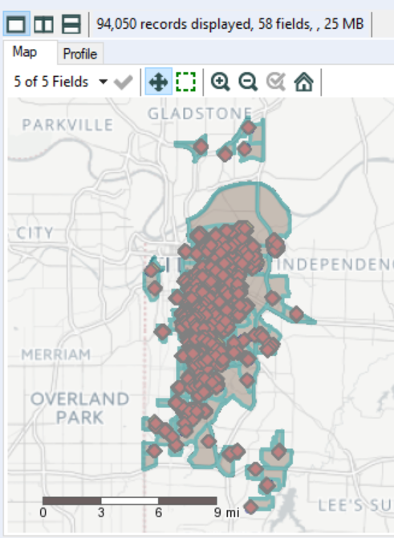
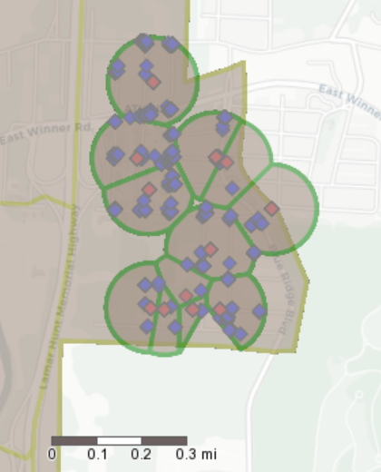
Environs: Land Bank Buffers
Non-overlap buffers
1,094 Land Bank Props:
.1 mile buffers
1.2m Metro KC

Slide 32
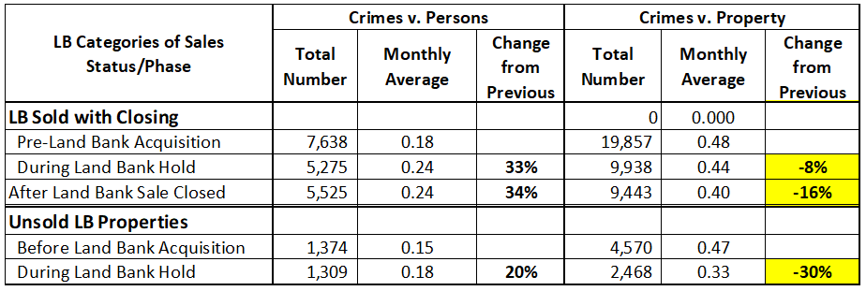
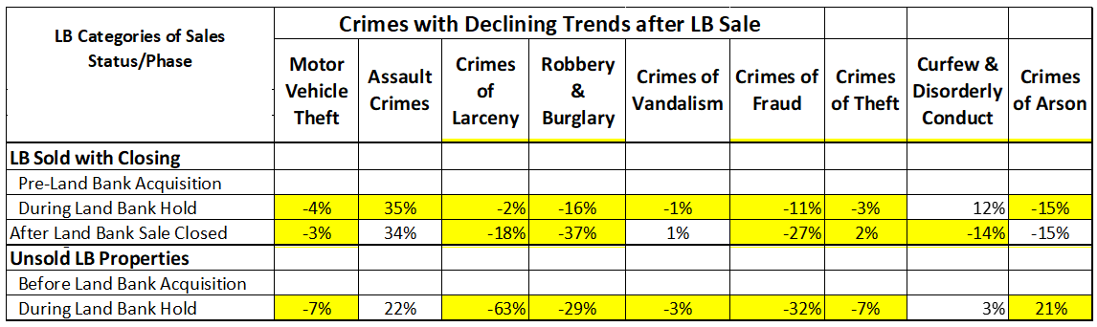
Crimes with Declining Trends After LB Sale

Slide 33
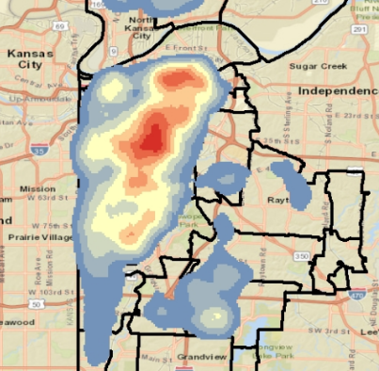
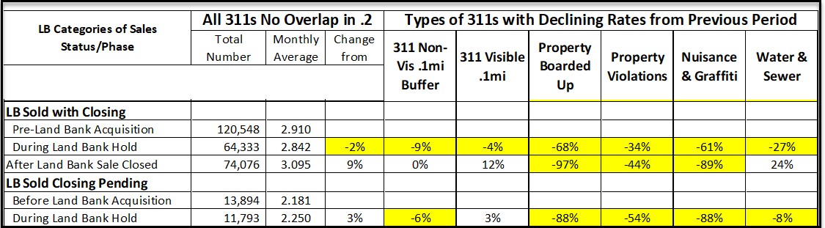
311s with Declining Trends
After LB Sale

Slide 34
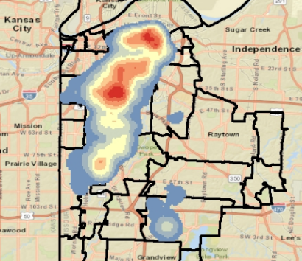
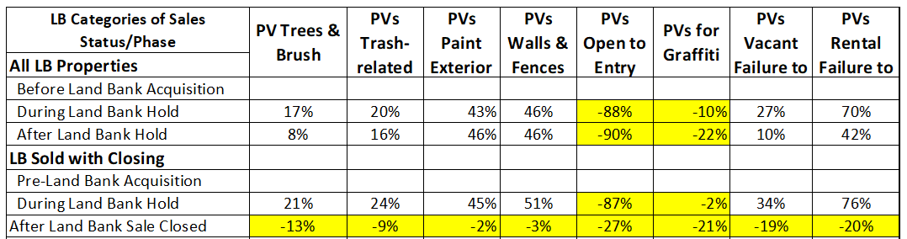
PVs with Declining Trends
After LB Sale

Slide 35
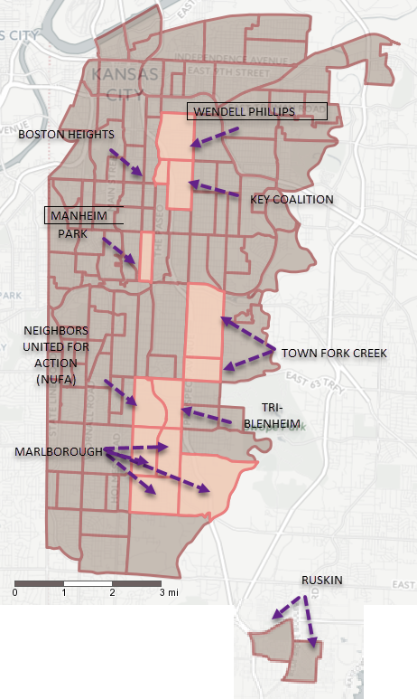
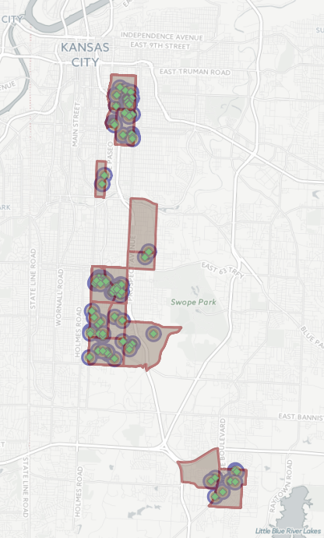
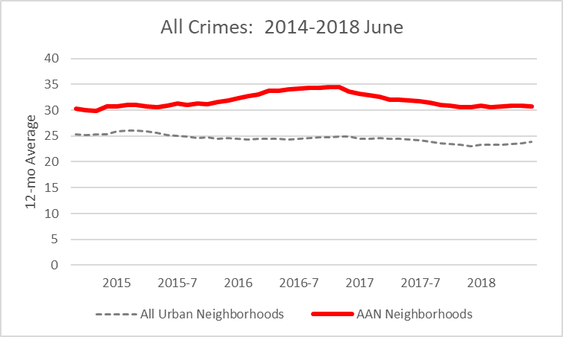
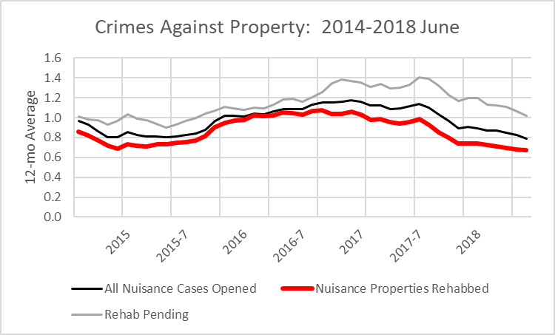
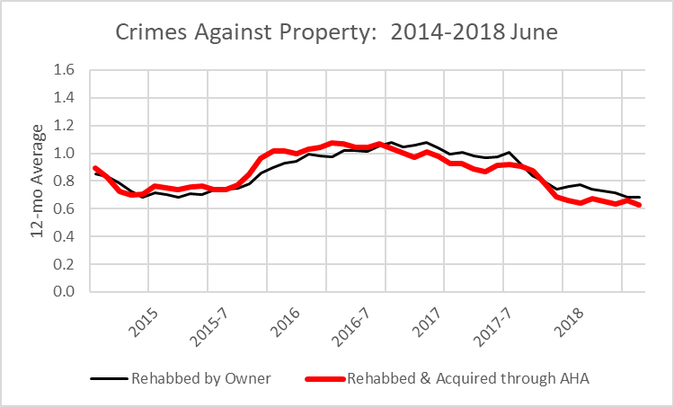
Application 2: Abandoned
Housing Act Interventions
Neighborhoods
Buffers
Abandoned Housing Act
Cases
Higher Crime Neighborhoods
Rehab is Key: Owner motivated vs. AHA Intervention
Rehabbing Mattered

Slide 36
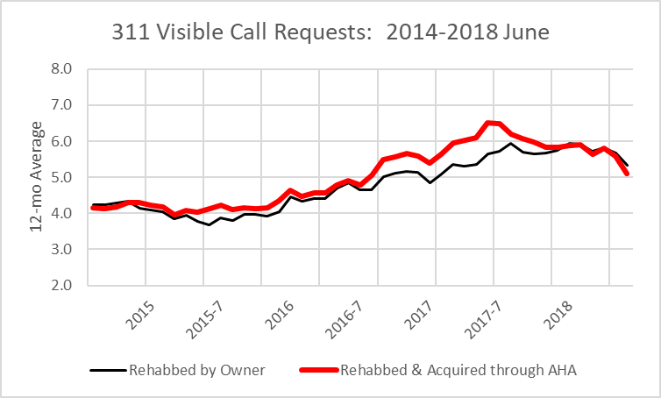
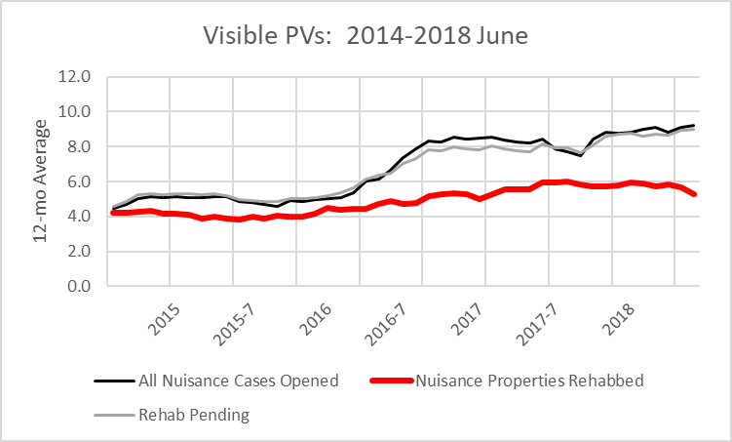
Abandoned Housing Cases:
Interaction w/ 311s and PVs
311 Call Requests
Property Violations
Owner-cured vs. AHA Rehabbed
Rehabbing Mattered

Slide 37
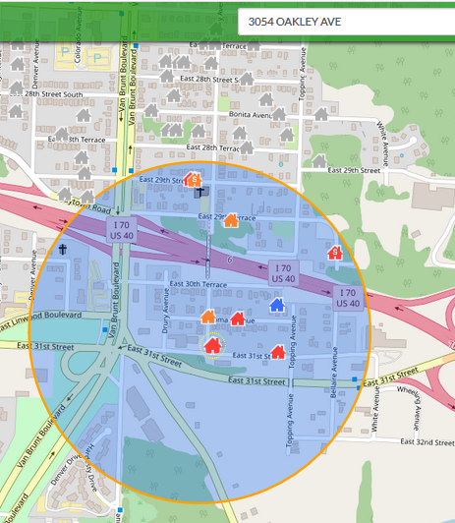
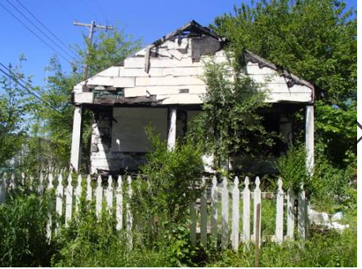
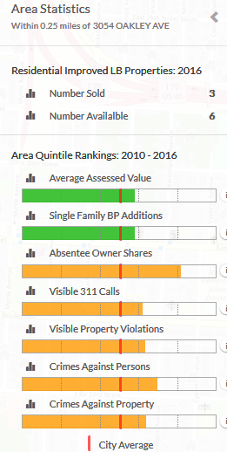
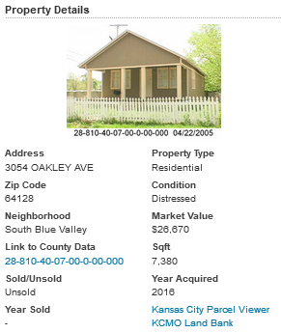
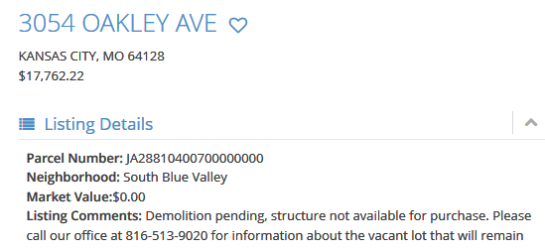
Application 3: v2V-Lb Website for Buyers
v2V-Lb

Slide 38
Analytics Tools

Slide 39


Excel: Pivot Tables

Slide 40

Alteryx
The "Alteryx for Good Program" provides Alteryx licenses for verified academics, students, and non-profits. By integrating Alteryx in real estate and other academic programs, faculty can provide students with a competitive edge in terms of cutting-edge analytics. To download the program description for educators, click on Alteryx for Good.Educator. To download program description for students, click on Alteryx for Good.Students From a pedagogical perspective, the lower learning curve required to master Alteryx's workflow modeling using drag-and-drop icon tools allows non-technical users to harness the power of big data without having to rely on complex programming languages. This opens the door to interjecting data science without compromising learning objectives focused on underlying industry fundamentals that it takes to succeed professional careers.

Slide 41

Tableau
Tableau has established free licenses for students and instructors to encougage adoption of its software. The program requires verification of academic status. The free licenses are available for Tableau, as well as Tableau Prep. The package supports spatial and other visualizations. Examples can be found at Tableau and on this page. Tableau has an extensive set of tutorials and support materials. For an introductory tutorial I prepared for my students, see: Introduction to Tableau for Real Estate-DeLisle.

